Slide 1
AZ-220T01 Module 11: Develop with Azure Digital Twins

Slide 2
Lesson 1: Learning objectives

Slide 3
Module 11 – Learning objectives
Describe the working components of an Azure Digital Twins (ADT) solution
Explain how to create and configure an ADT instance
Explain how to create, query, and manage the ADT graph
Explain how to implement ADT data ingress from IoT hub and data egress from ADT for downstream business analysis
Describe how to monitor and troubleshoot ADT

Slide 4
Lesson 2: Introduction to Azure Digital Twins

Slide 5
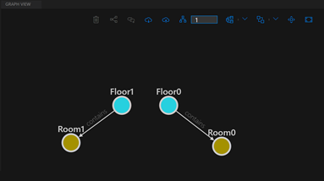
Get started with Azure Digital Twins
Azure Digital Twins is a platform as a service (PaaS) offering that enables the creation of knowledge graphs
The knowledge graph is composed of interconnected digital entities that combine to represent a larger, interactive digital environment
Notes:
This simple example of an ADT environment for a Building includes digital entities that represent the floors of the building, as well as the rooms that exist on each floor. For an ADT knowledge graph each entity (each node on the graph) represents a digital twin, which can be queried to extract data related to the business. For example, the temperature of a room.
The term "Azure Digital Twins" refers to the Azure Digital Twins service as a whole. The term “digital twin(s)“, or just "twin(s)“, refers to the digital entities represented within your solution.
The ADT environment show on the slide represents a small building. In this example, our building is comprised of digital twins that represent the floors of the building, as well as the rooms on each floor. The lines on the Graph that connect a Floor to a Room are called relationships. Relationships help to define how our digital twins are related to one another. In this case the relationship tells us that a floor “contains” rooms.
You may want to point out that “contains” is the name assigned to the relationship between Floor and Room and not a type of relationship or a key word. The relationship could have just as easily been named “has”.

Slide 6
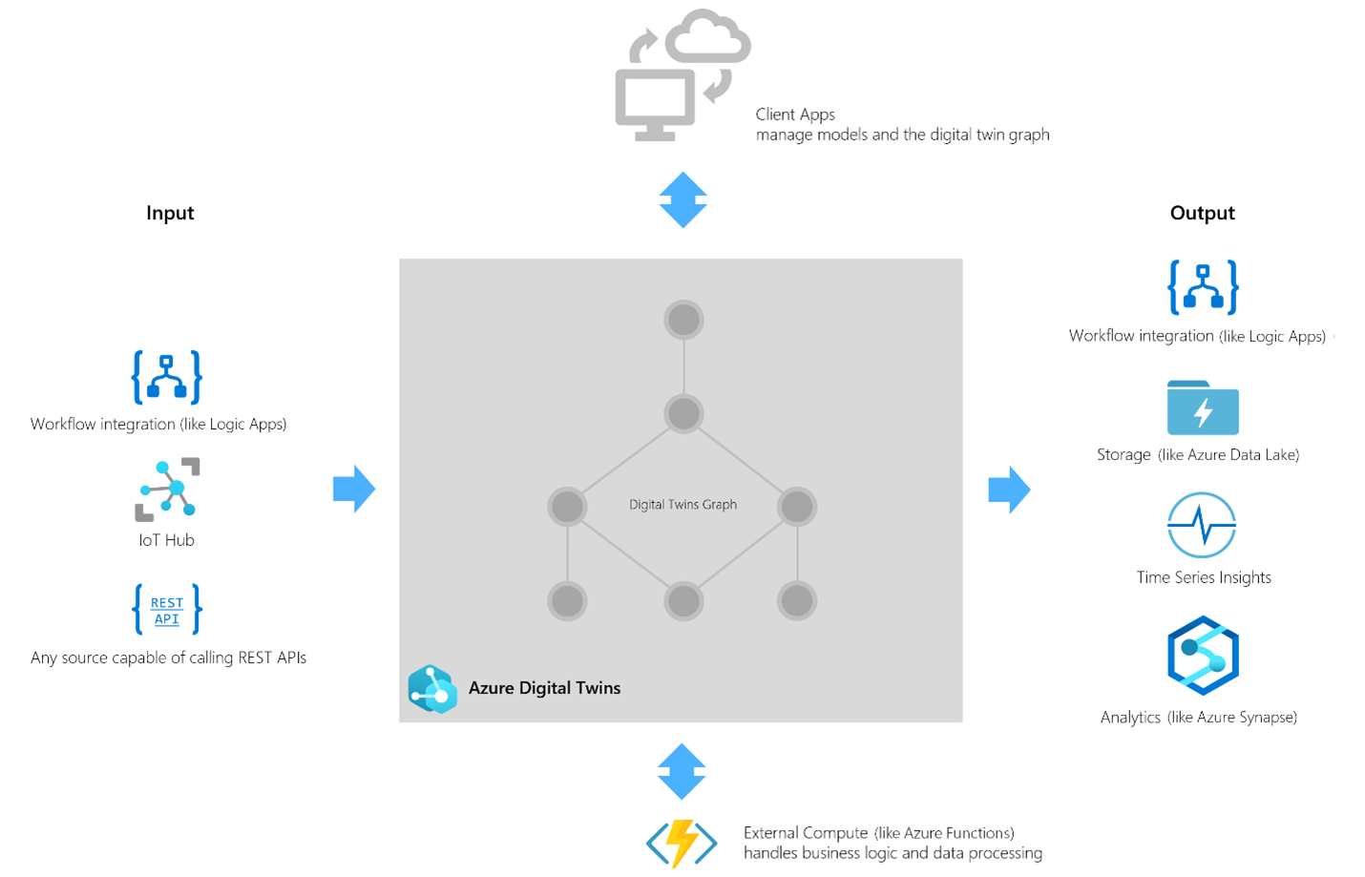
Examine an ADT solution
Azure Digital Twins is typically used together with other services to create flexible, connected solutions that use your data in a variety of workflows
Azure Digital Twins can receive data (Input) from upstream services such as IoT Hub or Logic Apps, which are used to deliver telemetry and notifications
Azure Digital Twins can also route data (Output) to downstream services, such as Time Series Insights or Azure Maps, for storage, workflow integration, analytics, and more
Notes:
Note: The next slide is also focused on ADT in a solution context, providing more of a use case approach.
Azure Digital Twins is commonly used in combination with other Azure services as part of a larger IoT solution.
A complete solution using Azure Digital Twins may contain the following parts:
- The Azure Digital Twins service instance. The ADT service stores your twin graph (which includes the state information for the environment) and orchestrates event processing.
- IoT hub can be used as an upstream service to provide device management and IoT data stream capabilities. Other input sources can also be included in the solution.
- Downstream services are used to handle tasks such as workflow integration (like Logic Apps, cold storage, time series integration, or analytics).
- External compute resources are used to process events generated by Azure Digital Twins and to connect with data sources such as IoT hub. One common way to provide compute resources is via Azure Functions.
- Client apps can be used when developing/implementing the Azure Digital Twins solution (to create digital entities and a topology, or to extract insights from the twin graph using queries).

Slide 7
Examine an ADT solution
Design and implementation scenario
Evaluation: Azure Digital Twins supports the ability to aggregate and combine data from multiple sources in a single, securely accessible location.
Design Flexibility: Azure Digital Twins supports any industry vertical investing in IoT and has the flexibility to connect the inputs and outputs that an individual company requires.
Implementation: Azure Digital Twins uses a robust event system to build dynamic business logic and data processing.
Results: Azure Digital Twins integration with analytics and AI services help you to track the past and predict the future.
Notes:
Note: This 2nd slide on ADT solutions is intended to help students get a feel for an ADT use case. Since ADT may be new to students, the discussion should remain high-level. There is a link to an ADT customer story below.
Contoso Scenario
Evaluation: With ADT, Contoso will be able to combine data from sales, marketing, facilities, and operations (including IoT Hub data) in a single and secure location. For example, a Contoso cheese factory ADT environment could report executive level information like percentage uptime, production volume, peak volume, operating costs, and profit margins. Digging deeper within the same graph environment, a front-line operator could observe cheese cave environment data, IoT sensor performance and connection records, and maintenance information. Each person can access aggregated data that is customized to their needs, all from a live and interactive environment.
Design Flexibility: The Azure Digital Twins environment supports upstream data sources and downstream services for nearly any business design requirement. Contoso is able to leverage their investment in an Azure IoT solution, making IoT hub one source of data input, and will be able to supplement their sensor data with business information from various departments. Support for downstream services, such as data analytics and storage, is also robust. Since ADT aggregates data from multiple sources, additional business opportunities are available for Contoso solution architects to investigate.
Implementation: Although ADT brings new terms and APIs, the tools used to implement your ADT solution will be familiar to the Azure IoT developer. Azure CLI, ADT SDKs, Visual Studio Code, and Azure Functions combine to jump-start the implementation process. Since the Azure IoT developers at Contoso are already familiar with these tools, management chooses to run a POC phase that focuses on ingesting IoT data, managing the ADT environment, and evaluating data with downstream services before combining business data into the solution in later phases. An Azure Digital Twins solution can start small and grow to meet the changing needs of the business.
Results: Azure Digital Twins leverages the same analytic and predictive AI services available to other Azure solutions, but by aggregating and combining data within a single source, new and more robust results are achievable.
Actual Customer Story: Microsoft Customer Story-Brookfield sets a new standard for innovation in real estate with WillowTwin and Azure Digital Twins

Slide 8
Get started with digital twin models
The top-level of a model definition is called an Interface. The Interface encapsulates the entire model, and may contain zero, one, or many of each of the following fields:
Property - Properties are data fields that represent the state of an entity (like the properties in many object-oriented programming languages)
Telemetry - Telemetry fields represent measurements or events, and are often used to describe device sensor readings.
Component - Components allow you to build your model interface as an assembly of other interfaces.
Relationship - Relationships let you represent how a digital twin can be involved with other digital twins.
Notes:
Digital twin models provide the blueprint that is used to create the digital twin entities within your Azure Digital Twins environment.
Within a model definition, the top-level code item is an Interface. The Interface encapsulates the entire model, and will contain zero, one, or many of the fields listed here.
Models will nearly always contain two or more Properties and at least one Relationship. Telemetry and Component fields are more situational, with Telemetry being tied to the need for streaming data and Components being tied to a logical subsystem of a Model. The example that Microsoft provides is a Model for a mobile phone that contains a Component for the embedded camera.
Since both Properties and Telemetry are data fields, it may appear that they could be used more interchangeably than is actually the case. The big difference is that Telemetry is more like a transitory event than a readable value, whereas a Property is a static value that has read/write capabilities. The skillpipe content includes an example that describes using the Telemetry field of a child digital twin (a Thermostat twin) to update a Property of the parent digital twin (a Room twin), in this case setting the current temperature property for the room.

Slide 9
Examine the Digital Twins Definition Language
Models for Azure Digital Twins are defined using the Digital Twins Definition language (DTDL), which is based on JSON-LD. The model contains the following fields.
Fields | Description
@id | An identifier for the model. Must be in the following format: dtmi:<domain>:<unique model identifier>;<model version number>
@type | Identifies the kind of information being described: Interface, Property, Telemetry, Relationship, or Component.
@context | Sets the context for the JSON document. Models should use the following: dtmi:dtdl:context;2
displayName | (optional) Allows you to give the model a friendly name if desired.
contents | All remaining interface (model) data is placed here, as an array of attribute definitions. Each attribute must provide an @type to identify the type of interface information it describes, and then a set of properties that define the actual attribute
Notes:
Note: This is slide 1 or 2 for the DTDL topic. This first slide describes the elements of a DTDL model file, the second slide presents an example of the DTDL JSON-LD code. You should consider how you want to split your time between the two slides before teach this topic for the first time.
The Digital Twins Definition language (DTDL), specifies the field structures that are available when designing ADT models. Each field follows a required format. This format ensures that digital twin instances in an ADT environment can created, updated, and deleted in a manageable way. Model version numbers enable you to have digital twins in your environment that represent, for example, different versions of their physical counterparts.

Slide 10
Examine the Digital Twins Definition Language
The following DTDL example for a Planet includes properties and telemetry as well as a relationship and component
[
{
"@id": "dtmi:com:contoso:Planet;1",
"@type": "Interface",
"@context": "dtmi:dtdl:context;2",
"displayName": "Planet",
"contents": [
{
"@type": "Property",
"name": "name",
"schema": "string"
},
{
"@type": "Property",
"name": "mass",
"schema": "double"
},
{
"@type": "Telemetry",
"name": "Temperature",
"schema": "double"
},
{
"@type": "Relationship",
"name": "satellites",
"target": "dtmi:com:contoso:Moon;1"
},
{
"@type": "Component",
"name": "deepestCrater",
"schema": "dtmi:com:contoso:Crater;1"
}
]
},
{
"@id": "dtmi:com:contoso:Crater;1",
"@type": "Interface",
"@context": "dtmi:dtdl:context;2"
},
{
"@id": "dtmi:com:contoso:Moon;1",
"@type": "Interface",
"@context": "dtmi:dtdl:context;2"
}
]
Notes:
You can let student know that although the formatting requirements must be adhered to for the model to be implemented successfully, they won’t need to memorize every structure or schema during this course. However, they should gain an understanding of the basic elements and how they are used to construct a model.
You may want to point out the schemas supported by the various fields. It may also be good to spend a little time describing how relationships are defined, as this may be more conceptually difficult than properties or telemetry.
Note: The skillpipe content introduces the concept of model inheritance, which may be important to some real-world ADT implementations, but there just isn’t enough time to cover it in this course.

Slide 11
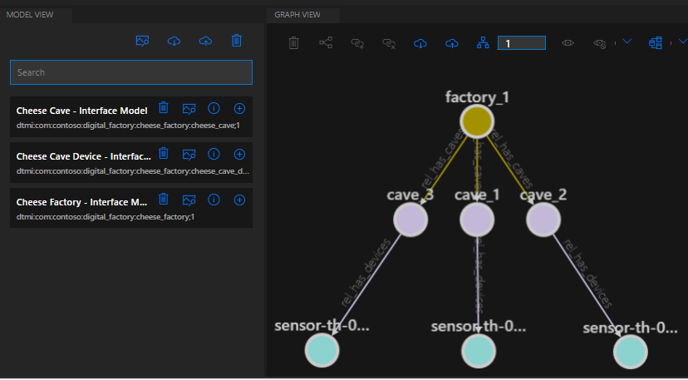
Examine digital twins and graph construction
The first step in adding a digital twin to ADT is to upload a model type to your ADT instance
After creating and uploading a model, you can create one or more instances of the model type; your digital twins
Digital twins are connected into a twin graph by their relationships (which must be defined as part of the model)
Notes:
Note: This slide is intended to help the students understand the relationships between the ADT service, the models, the digital twins, and the graph of the ADT environment. It also reinforces the sequence in which these items created/implemented.
Once you have created your ADT service instance, configured access permissions, and defined your models, you are ready to begin building the ADT environment. Which means that you can finally start creating digital twins and implementing the relationships that exist between on twin and another.
A model must be uploaded to ADT before you can add a digital twin to your environment. Once created, the digital twin is available as a node on the graph and can be connected to other twins using relationships. You can also access twin data using queries. Once you have moved from building your ADT environment to managing, updating, and versioning, models will be required in order to edit digital twin properties.
Although you can create digital twins and define relationships programmatically without ever “seeing” the environment, you may find it helpful to visualize the ADT environment in the form of the ADT graph. For example, after creating a model of type Cheese Cave, you can create one or more digital twins that use this type (such as cave_1, cave_2, and cave_3). Visualizing the graph also makes it easier to understand when and where to apply relationships. For complex environments, queries can be used to filter the portion of the environment that is being visualized.
The Azure portal UI (an ADT resource in the portal) does not include a way to visualize the graph, but Microsoft does provide an ADT-explorer sample app that enables you to build, visualize, and even manage certain aspects of the graph. The next lesson will focus on the tools that can be used to build and manage your ADT solution.

Slide 12
Lesson 3: Introduction to ADT solution development

Slide 13
Get started with the ADT service and tools
The Azure Digital Twins service comes equipped with APIs for managing your ADT instance and its elements. Multi-purpose and ADT-specific tools are available for various stages of solution develop.
ADT Solution Stage/Area | Azure Portal | Azure CLI | SDKs (VSCode) | DTDL Validator | ADT-explorer | CSV (Excel) | Azure Functions | REST APIs (Postman)
Create/Configure ADT instance | x | x | x |  |  |  |  | x
Develop DTDL Model files |  |  | x | x
Build Graph Environment |  | x | x |  | x | x |  | x
Query/Manage Graph Environment |  | x | x |  | x |  |  | x
Manage Data Ingress (upstream) | x |  |  |  |  |  | x
Manage Data Egress (downstream) | x |  |  |  |  |  | x
Note: The list of tools above is not intended to be a complete list of the tools that can be used to develop an ADT solution.
Notes:
The goal of this slide is to introduce students to the solution development stages that they will be involved in (as Azure IoT Developers) when working on an ADT solution, and to provide initial awareness concerning the tools that they may use when working to complete that stage of the overall project.
With that in mind, you may want to first work your way down the leftmost column describing the stages, and then start over again at the top of the list, briefly describing the tool options at each stage. This is not the time for a deep dive on the tools.
For example, after your initial walkthrough of the development stages, you could offer something like the following for the Create/Configure stage: “When you create your first ADT instance, it makes sense to do it in the Azure portal rather than programmatically. However, if you encounter repetitive configuration tasks, a programmatic approach makes a lot of sense. Using a tool like Postman to evaluate the REST APIs or test out certain configuration tasks can also be helpful.”

Slide 14
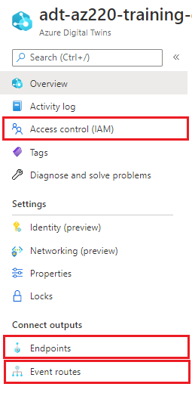
Examine ADT service configuration
To create an ADT instance, you must specify an Azure subscription, a resource group, a location, and a resource name.
Access control permissions must be configured for an ADT instance. The Azure Digital Twins Data Owner role is required for a user or app to access ADT data.
Endpoints are used to make ADT event data available to downstream services. An ADT instance supports the following Endpoint types: Event Grid, Event Hubs, and Service Bus.
Event routes specify which events generated by Azure Digital Twins are delivered to which endpoints. A routing filter is used to restrict the types of events being sent.
Notes:
The initial setup for a new Azure Digital Twins instance consists of two parts:
- Create the ADT service instance
- Set up user access permissions: Azure users will need to have the Azure Digital Twins Data Owner role on the Azure Digital Twins instance to be able to manage the ADT service and its data.
- To set up user access permissions in ADT, you will need access to an Azure account that can assign user access permissions for the subscription that you are working in.
In Azure Digital Twins, you can route event notifications to downstream services or connected compute resources. This is done by first setting up endpoints that can receive the events. You can then create event routes that specify which events generated by Azure Digital Twins are delivered to which endpoints.
Azure Digital Twins supports the following endpoint types: Event Grid, Event Hubs, Service Bus. The endpoint must exist before you can link to it.
An event route definition contains these elements:
- The route name you want to use
- The name of the endpoint you want to use
- A filter that defines which events are sent to the endpoint

Slide 15
Get started with model management
Validate and upload - validate your models offline before uploading them
Validation tools: DTDL Validator, DTDL Editor for Visual Studio Code
Upload options: APIs, Azure CLI, SDKs, ADT-Explorer, ADT Model Uploader
Update and version - models uploaded to ADT cannot be edited
You must upload a newer version to replace an older model
The old model version(s) are used by existing digital twins until the twins are updated (patched)
New digital twins can be created using any available version of a model
Removal – unused models can be removed (decommissioned or deleted)
Twins that were created from a model that has been decommissioned can still be updated.
Twins that were created from a model that has been deleted cannot be updated until they are assigned to another model. Twins can still be queried even after their model is deleted.
Notes:
Note: Some students may not be familiar with the concept of “patching” JSON. If that’s the case, you may want to spend a little time introducing the topic. You can also open the following web page or direct student to it (or another reference of your choice): https://docs.microsoft.com/en-us/aspnet/core/web-api/jsonpatch?view=aspnetcore-5.0#json-patch
Validate and upload: You should always validate your models before uploading. The DTDL validator works well, but currently it reports errors one at a time, so if the file contains three error, you will need to run the tool three times to find them. The DTDL extension for Visual Studio Code supports both model authoring and validation. The tool uses Intellisense to help you with the language syntax (including auto-completion) and syntax validation.
Update and version: Once a model is uploaded to your Azure Digital Twins instance, the entire model interface is immutable. This means there is no traditional "editing" of models. Azure Digital Twins also does not allow re-upload of the same model. Instead, if you want to make changes to a model - such as updating displayName or description - the way to do this is to upload a newer version of the model. To indicate a newer version, simply increment the version number of the model. New versions do not overwrite earlier versions of the model, so multiple versions of the model will coexist in your instance until you remove them, and a new twin can use either the new version of the model or the older version. Existing twins will remain instances of the old model version until you update them to the new model version by patching them.
Removal: Models can also be removed from the service, in one of two ways:
Decommissioning : Once a model is decommissioned, you can no longer use it to create new digital twins. Existing digital twins that already use this model aren't affected, so you can still update them with things like property changes and adding or deleting relationships.
Deletion : This will completely remove the model from the solution. Any twins that were using this model are no longer associated with any valid model, so they're treated as though they don't have a model at all. You can still read these twins, but won't be able to make any updates on them until they're reassigned to a different model.

Slide 16
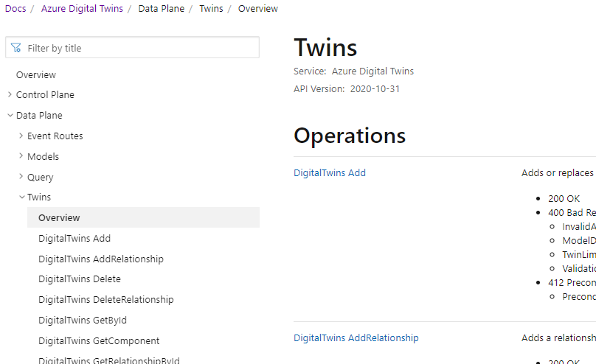
Explore the ADT APIs and Postman
Azure Digital Twins API reference documentation
Control Plane APIs: used to manage your Azure Digital Twins instance. API categories:
Check Name Availability
Digital Twins Instance
Endpoints
Operations
Private Endpoints
Data Plane APIs: used to manage elements of the ADT instance. API categories:
Event Routes
Models
Query
Twins
Notes:
You can find the Azure Digital Twins REST API reference documentation at the following location: https://docs.microsoft.com/en-us/rest/api/azure-digitaltwins/
In addition to a basic description of the control plane and data plane APIs, the documentation provides detailed information describing headers, responses, security, and examples for each API.
The control plane APIs are used to manage your Azure Digital Twins instance
The data plane APIs are used to manage the elements within your Azure Digital Twins instance

Slide 17
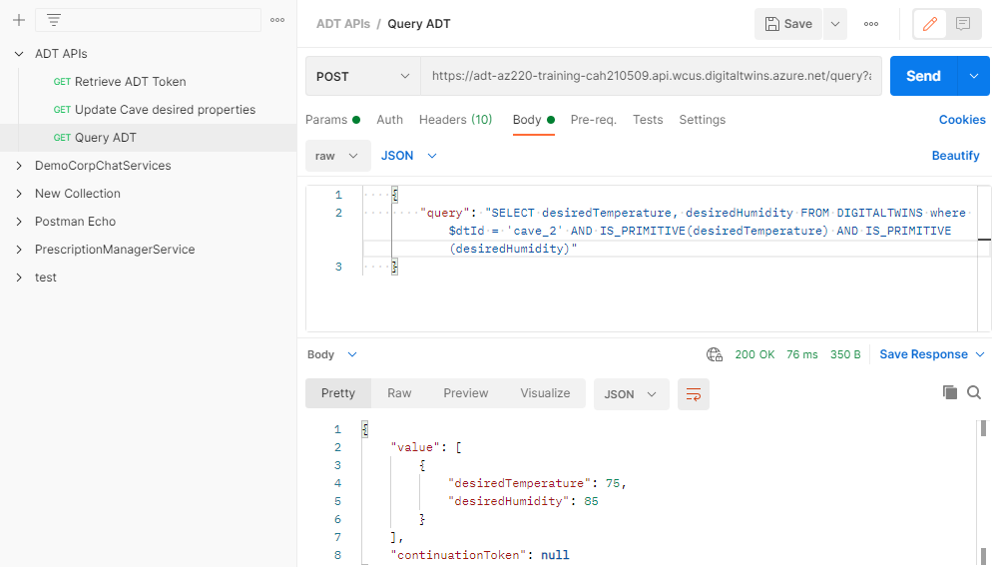
Explore the ADT APIs and Postman
Three steps to using Postman
Step 1: authorize Postman to make requests against the ADT APIs with a bearer token
Step 2: set up (or import) a collection of Postman requests for ADT
Step 3: edit the details of a request in the Postman collection run the request with the Send button
Notes:
Postman is a good tool for evaluating REST APIs, and Microsoft has prepared request collections for ADT that can be used in Postman to evaluate the ADT APIs. This can be helpful when you are initially exploring the API or when you need to debug code that isn’t working as you expected.
Setting up Postman includes enough configuration overhead that it may not be your go-to tool for a casual look at the ADT APIs.

Slide 18



Get started with Azure CLI for ADT
The Azure CLI command set for ADT is part of the Azure IoT extension for Azure CLI
Azure CLI examples for ADT
Create an ADT instance
Azure CLI commands can be used for:
Managing an ADT instance
Managing models
Managing digital twins
Managing twin relationships
Configuring endpoints
Managing routes
Configuring security via Azure role-based access control (Azure RBAC)
Create a digital twin
Delete a digital twin

Slide 19
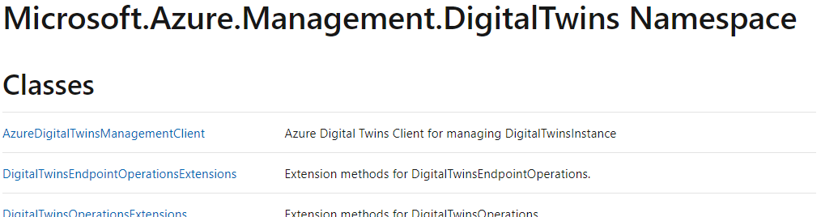
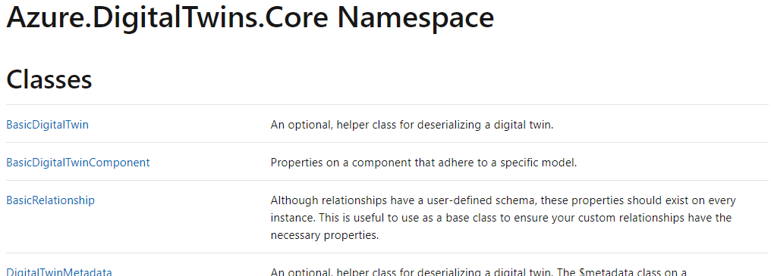
Examine the ADT SDKs
ADT SDKs cover Control plane and Data plane APIs with language support as follows:
Control plane: .NET (C#), Java, JavaScript, Python, Go
Data plane: .NET (C#), Java, JavaScript, Python
ADT SDKs can be used to:
Instantiate the client
Create, get, and remove models
Create, query, and delete a digital twin
Get and update components for a digital twin
Create, get, and delete digital twin relationships
Create, get, and delete event routes
Publish telemetry messages to a digital twin and digital twin component

Slide 20
Manage digital twins in the graph
You can manage twins in code using system client methods and helper functions
To create a twin, use the CreateOrReplaceDigitalTwinAsync() method:
await client.CreateOrReplaceDigitalTwinAsync<BasicDigitalTwin>(twinId, initData);
To access twin data, use the GetDigitalTwin() method:
Response<BasicDigitalTwin> twinResponse = await client.GetDigitalTwinAsync<BasicDigitalTwin>(twinId);
twin = twinResponse.Value;
To update a digital twin, pass a JSON Patch document into an UpdateDigitalTwin() method:
await client.UpdateDigitalTwinAsync(twinId, updateTwinData);
To update a digital twin's model, apply a patch using the UpdateDigitalTwin() method:
await client.UpdateDigitalTwinAsync(twinId, updateTwinData);
To delete a digital twin, use the `DeleteDigitalTwin()` method:
await client.DeleteDigitalTwinAsync(twinId);
Notes:
Note: Some students may not be familiar with the concept of “patching” JSON. If that’s the case, you may want to spend a little time introducing the topic. You can also open the following web page or direct student to it (or another reference of your choice): https://docs.microsoft.com/en-us/aspnet/core/web-api/jsonpatch?view=aspnetcore-5.0#json-patch
Some common digital twin management tasks include creating, modifying, and deleting digital twins, as well as extracting twin data.
Custom apps, such as the ADT-explorer, can be used to update digital twins in the graph, but that is a manual process and graph updates are generally driven by data ingress from an upstream service like IoT hub.
You can manage twin updates programmatically using the Digital Twins APIs, the Azure Digital Twins CLI, and the .NET (C#) SDK. Since Azure Functions are often used to manage digital twins, we are examining a .NET (C#) SDK implementation.

Slide 21
Manage digital twin relationships in the graph
To create a relationship, use the CreateOrReplaceRelationshipAsync() method:
await client.CreateOrReplaceRelationshipAsync<BasicRelationship>(srcId, relId, relationship);
To list relationships, use GetRelationshipsAsync() or GetIncomingRelationshipsAsync():
AsyncPageable<BasicRelationship> rels = client.GetRelationshipsAsync<BasicRelationship>(dtId);
AsyncPageable<IncomingRelationship> incomingRels = client.GetIncomingRelationshipsAsync(dtId);
To update a relationship, use the UpdateRelationship() method:
await client.UpdateRelationshipAsync(srcId, relId, patchDocument);
To delete a relationship, use :
await client.DeleteRelationshipAsync(srcId, relId);
Notes:
To create a relationship
To create a relationship, you need to specify:
- The source twin ID: The ID of the twin where the relationship originates.
- The target twin ID: The ID of the twin where the relationship arrives.
- A relationship name: The generic type of relationship, something like ”contains”.
- A relationship ID: The specific name for this relationship, something like ”Relationship1”.
Note: the code on this slide includes a “relationship” parameter of tyep BasicRelasionship that contains the target ID, the relationship name, and properties of the relationship
To list relationships
Relationships can be classified as either:
- Outgoing relationships: Relationships belonging to this twin that point outward to connect it to other twins. The GetRelationshipsAsync() method is used to get outgoing relationships
- Incoming relationships: Relationships belonging to other twins that point towards this twin to create an "incoming" link. The GetIncomingRelationshipsAsync() method is used to get incoming relationships
Note: These methods return an Azure.AsyncPageable<T> collection that you can loop through to find a particular relationship, for example, the relationship that connects to a Parent or Child twin that you are interested in.
To update a relationship
The required parameters for the client call are the ID of the source twin (the twin where the relationship originates), the ID of the relationship to update, and a JSON Patch document containing the properties and new values you'd like to update.
Note: This method is used to update the properties of a relationship. If you need to change the source twin or target twin of the relationship, you'll need to delete the relationship and re-create one using the new twins.
To delete a relationship
In the slide example, the first parameter specifies the source twin (the twin where the relationship originates). The other parameter is the relationship ID. You need both the twin ID and the relationship ID, because relationship IDs are only unique within the scope of a twin.

Slide 22
Get started with ADT queries
ADT query language:
- a custom SQL-like query language
- similar to the IoT hub query language
Example Queries
List of all digital twins in the instance:
SELECT * FROM DIGITALTWINS
Get digital twins by properties
SELECT * FROM DIGITALTWINS T WHERE T.Temperature = 70
Query by model
SELECT * FROM DIGITALTWINS WHERE IS_OF_MODEL('dtmi:example:thing;1’)
Query by relationship
SELECT T, CT FROM DIGITALTWINS T
JOIN CT RELATED T.contains WHERE T.$dtId = 'ABC'
Queries can be based on:
- properties of the twin
- models
- relationships
- properties of a relationship
Query limitations include:
- Up to 10 second delay between graph updates and query results
- No subqueries within FROM
- No support for OUTER JOIN
- No more than 5 JOIN levels
- Relationships can't be queried as independent entities

Slide 23
Get started with Azure functions for ADT
Use the following process to implement an Azure function
Create an Azure Functions project
Write the function code:
Add authentication code to the function (for accessing ADT)
Add code that will interact with ADT (and other Azure resources)
Publish the function app to Azure
Configure security access for the function app in Azure
The Azure function will interact with either upstream or downstream Azure services. Azure resource configuration before and/or after creating the Azure function will be required.

Slide 24
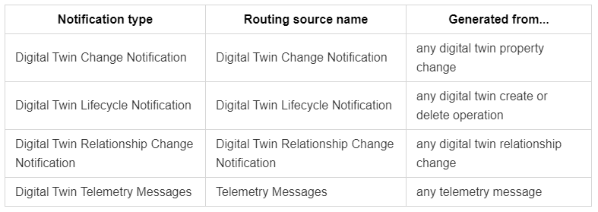
Examine ADT event data
Event notification types
In general, notifications are made up of two parts: the header and the body.
Notes:
Note: This is slide 1 of 2 on this topic. The next slide looks at a twin change notification (twin update)
Event notification headers
Notification message headers are represented with key-value pairs.
Event notification bodies
The bodies of notification messages are typically described in JSON. The set of fields that the body contains vary with different notification types.

Slide 25
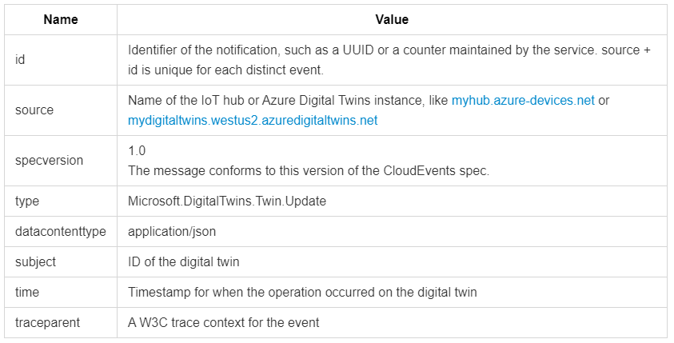
Examine ADT event data
Digital twin change notifications
Digital twin change notifications are triggered when a digital twin is updated:
When property values or metadata changes
When digital twin or component metadata changes
The body for the Twin.Update notification is a JSON Patch document containing the update to the digital twin

Slide 26
Examine data ingress and egress processes
An Azure Digital Twins solution relies on external resources for data inputs as well as analysis and storage of data outputs. ADT workflows fall into three main categories:
Data ingress – ingesting data from upstream resources
Data egress – using ADT data for in-service updates
Data egress – providing ADT data to downstream resources
Notes:
Note: this is slide 1 of 4 on this topic. The 3 categories are reviewed on the following slides

Slide 27
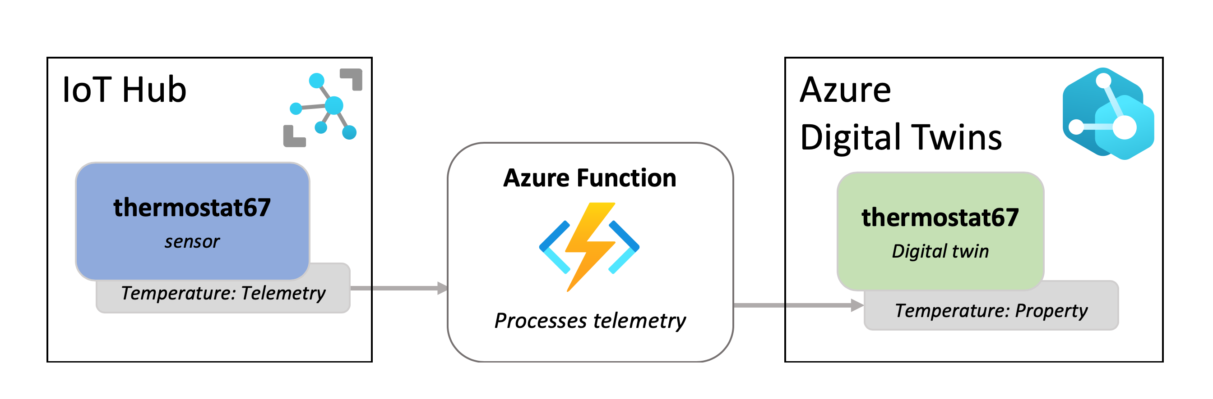
Examine data ingress and egress processes
Data Ingress (data ingestion from an upstream resource)
Notes:
Consider a scenario that includes the following:
- A thermostat device in IoT Hub
- A digital twin in ADT to represent the device
- When IoT hub receives telemetry containing temperature values from the device, you need to set a temperature Property of the corresponding digital twin
Solution: In this case, an Azure Function receives the data from IoT hub's built-in Event Grid endpoint and uses the ADT APIs to set properties on a corresponding digital twin contained within an ADT instance. The Azure Function could also be used to pass temperature telemetry to a Telemetry field of the digital twin.

Slide 28
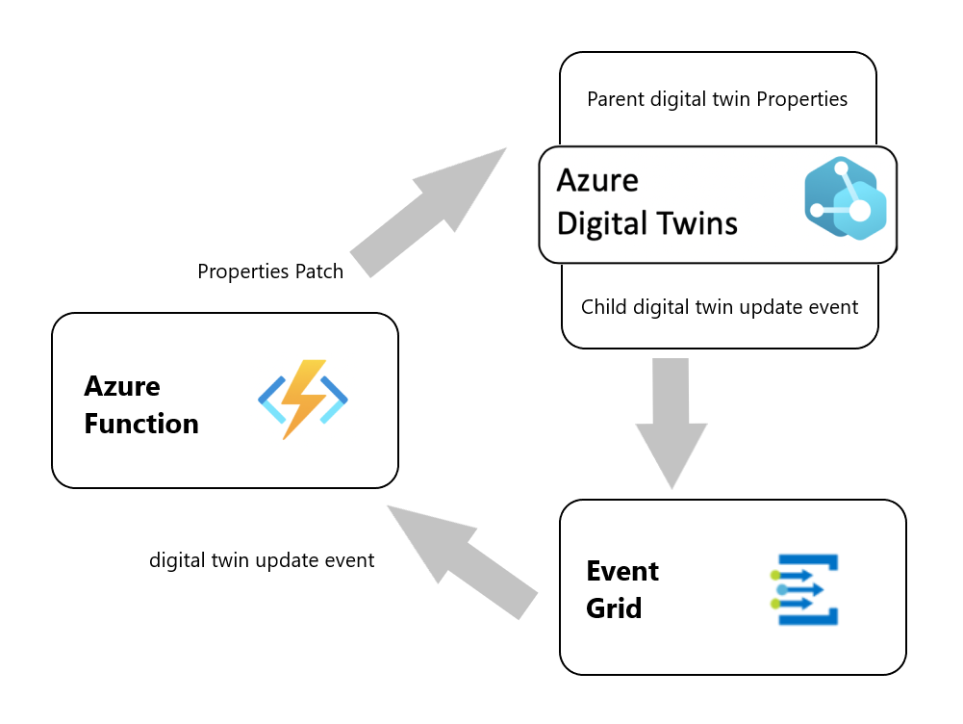
Examine data ingress and egress processes
Data Egress (in-service update – update parent twin property)
ADT uses digital twin change notification events as a trigger to route data to an ADT endpoint.
An Event Grid endpoint is used to transfer the digital twin change notification message, such as a twin update, to an Azure Function.
An Azure Function extracts data from the notification header and body and uses that data to get additional information from ADT, such as finding a parent digital twin. The function then performs the required action.
Notes:
Consider a scenario that includes the following:
- An ADT environment contains Room digital twins (such as Room_01, Room_02, etc.) and Thermostat digital twins (such as thermo_0001).
- The Room digital twins have a rel_has_thermostat relationship and each Room has a Thermostat (establishing a Parent-Child relationship).
- The Thermostat digital twins have a temperature_value Property and a Telemetry field for temperature data that is coming from IoT hub
- Room digital twins have a currentTemp Property that contains a current temperature value.
- When a Thermostat digital twin’s temperature_value Property changes, you need to update the currentTemp Property of the Room digital twin. The update must be applied to the Room digital twin that is the parent of that Thermostat digital twin.
Solution: Whenever a Digital Twin Change Notification event occurs for a Thermostat digital twin, the following process is invoked:
- data is routed to an Event Grid endpoint
- the Event Grid uses an Event Subscription to specify an Azure Function "listener“, creates a new event message using the ADT notification, and uses the new event to pass the required information to the function
- the Azure Function extracts the event massage data and uses it to obtain the twin’s ID and Relationship information, uses the Relationship to find the parent Room digital twin, and then updates the currentTemp Property by applying a patch

Slide 29
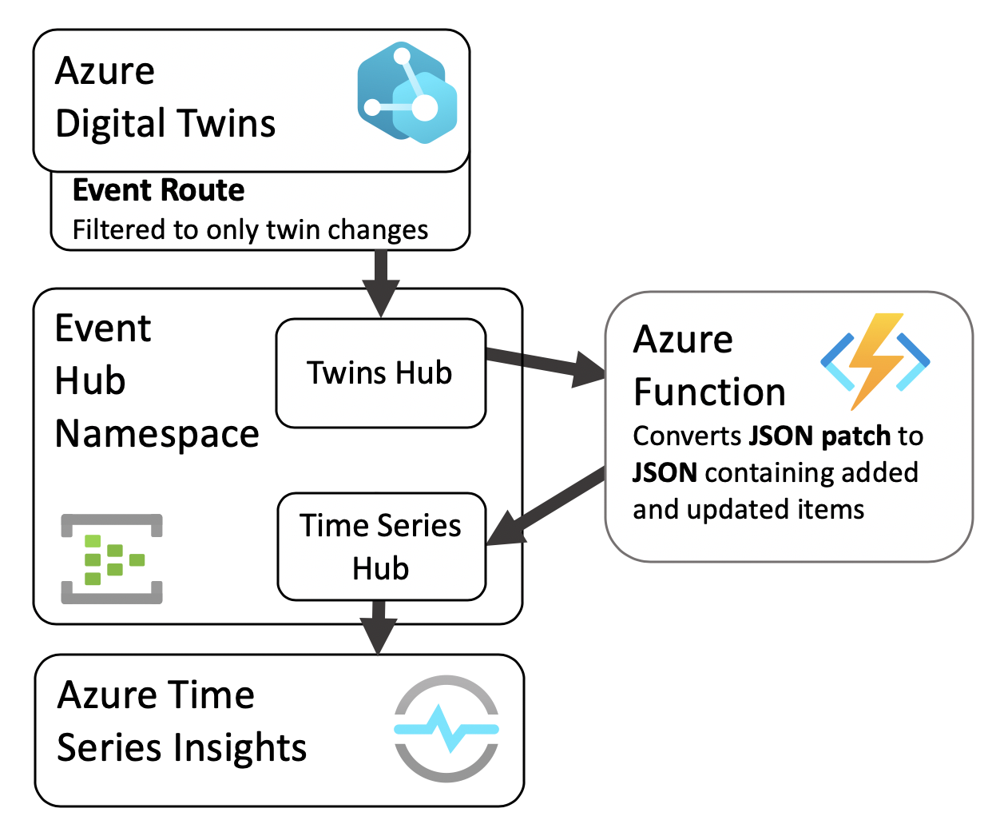
Examine data ingress and egress processes
Data Egress (downstream service support – Time Series Insights)
ADT streams data to downstream services by routing events through an Event Hubs Namespace
The Event Hubs Namespace will include an Event Hub that receives events from ADT and an Event Hub that feeds events to the downstream service. An Azure Function is used to prepare message data and apply event formatting that is appropriate for the downstream service
A downstream service, such as Time Series Insights, consumes the events from the second Event Hub
Notes:
Consider a scenario that includes the following:
- An ADT environment contains Room digital twins (such as Room_01, Room_02, etc.) and Thermostat digital twins (such as thermo_0001).
- The Room digital twins have a rel_has_thermostat relationship and each Room has a Thermostat.
- Room digital twins also have a Property for currentTemp.
- The Thermostat digital twins have Property and Telemetry fields for temperature data coming from IoT hub
- You need to analyze the temperature Telemetry data using Azure Time Series Insights.
Solution: Whenever a Digital Twin Telemetry Messages event notification occurs for a Thermostat digital twin, the following process is invoked:
- data is routed to an Event Hub endpoint
- the Event Hub processes events and triggers an Azure Function
- the Azure Function creates a new event for TSI, adds a partition key, and then publishes the new event to another Event Hub
- Azure TSI (subscribed to events from the second Event Hub) processes the incoming events to perform the required data analysis

Slide 30
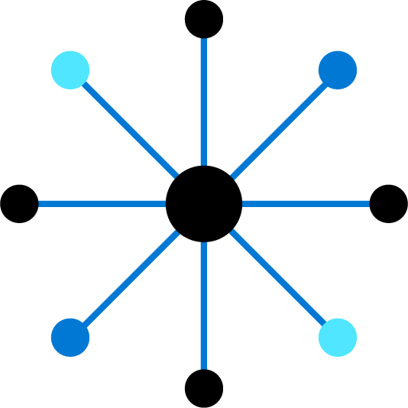
Lesson 4: Monitor and troubleshoot ADT

Slide 31
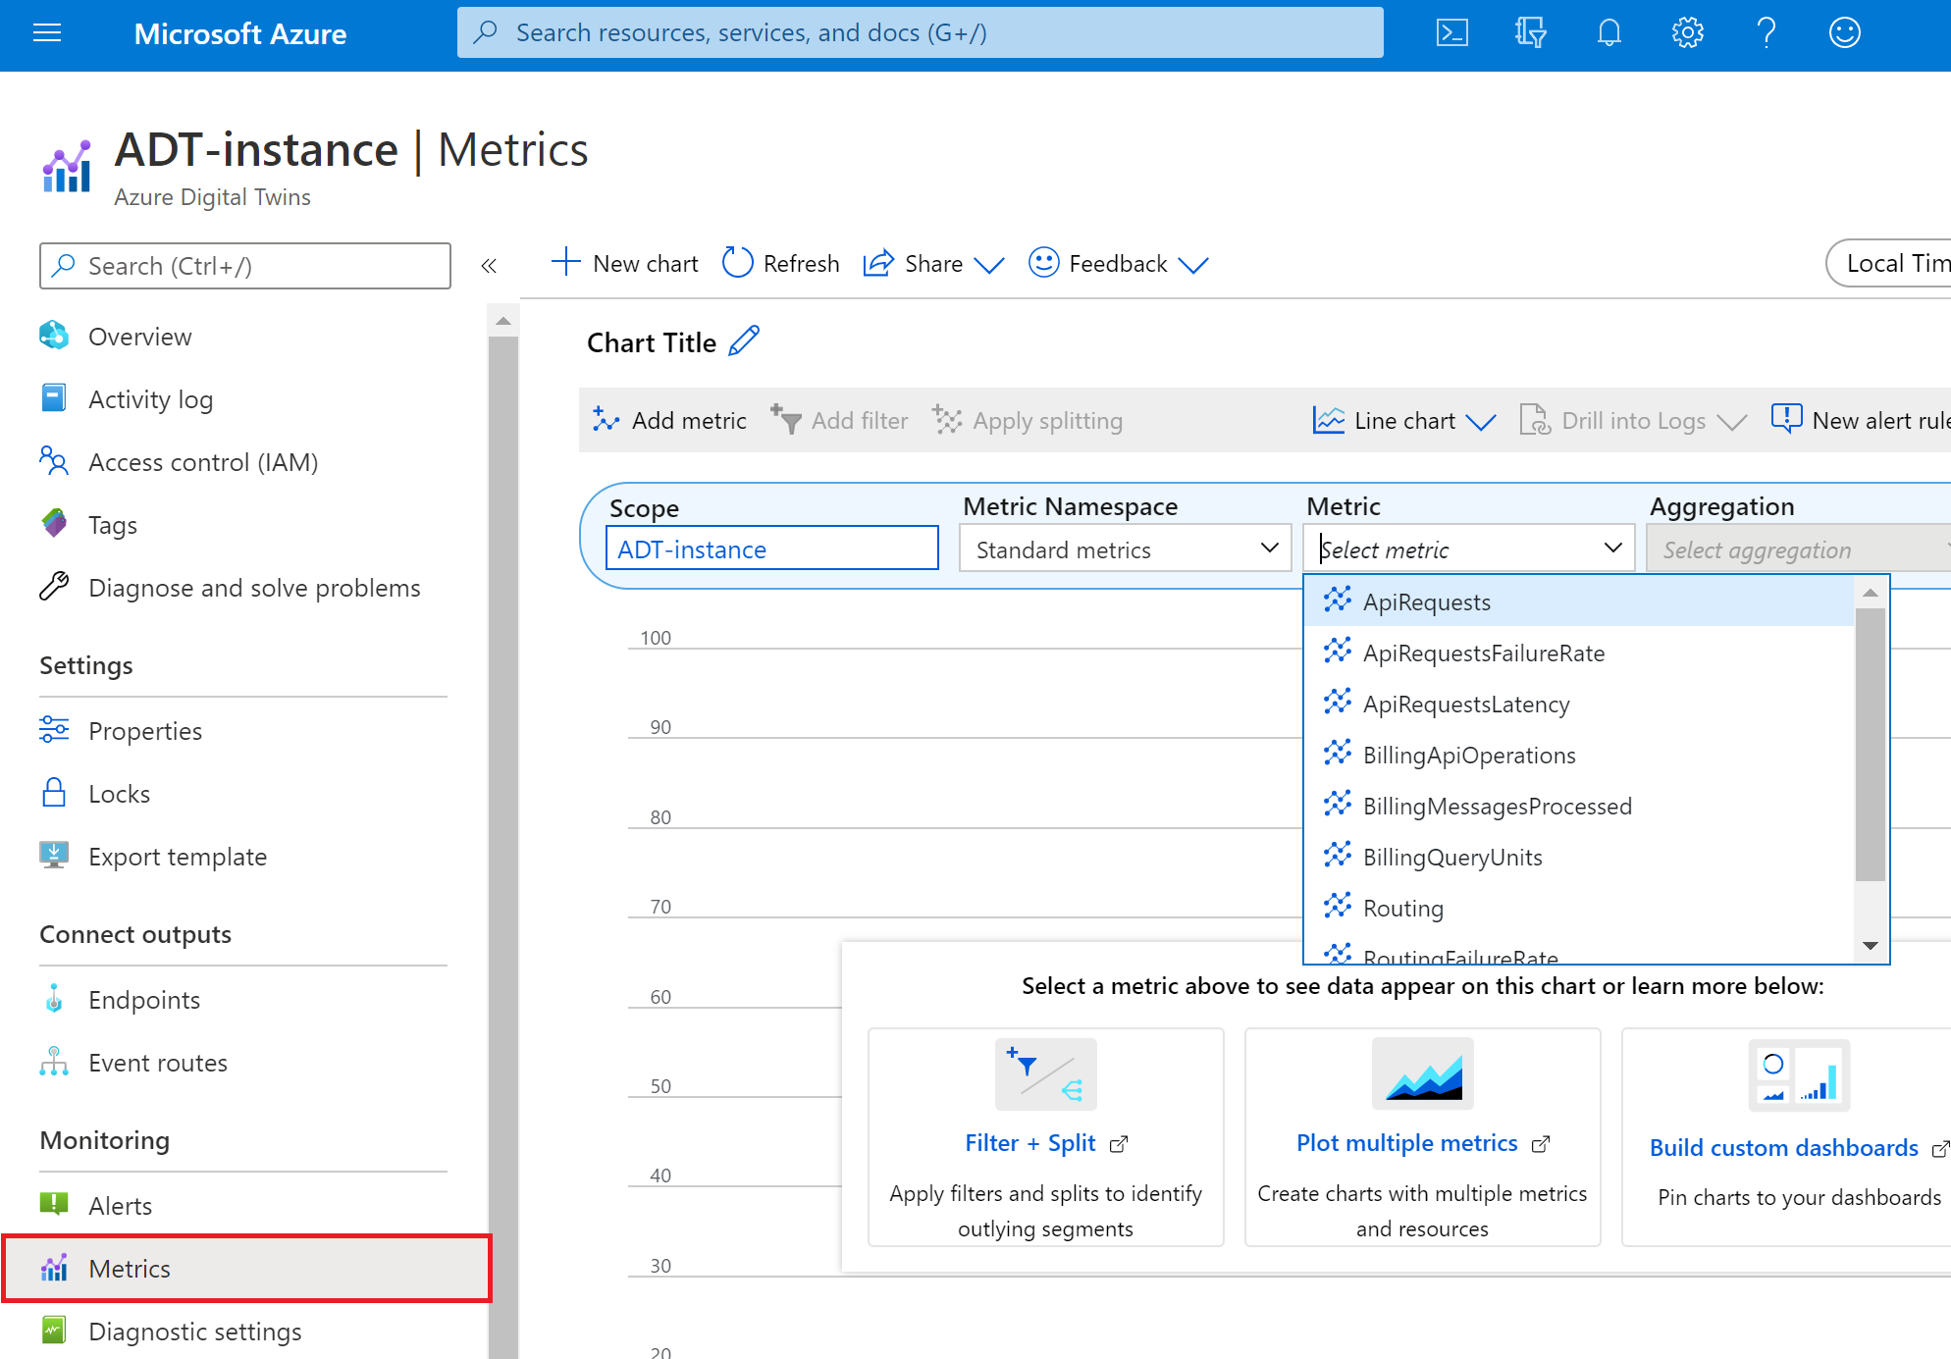
Examine the Azure Digital Twins metrics
Metrics for tracking service limits can be used, for example, when you're approaching a published service limit for some aspect of your solution
Metrics for tracking data ingress can be used, for example, when you need to monitor the number of incoming telemetry events
Metrics for tracking routing operations can be used, for example, when you need to monitor the number of messages routed to an endpoint
Notes:
Azure Digital Twins provides metrics, accessible through the Azure portal, that give you an overview of the health of your instance and its associated resources.
The ADT metrics are divided into the following categories:
Metrics for tracking service limits – includes: TwinCount and ModelCount
Ingress metrics – includes: IngressEvents, IngressEventsFailureRate, and IngressEventsLatency
Routing metrics
API request metrics
Billing metrics

Slide 32
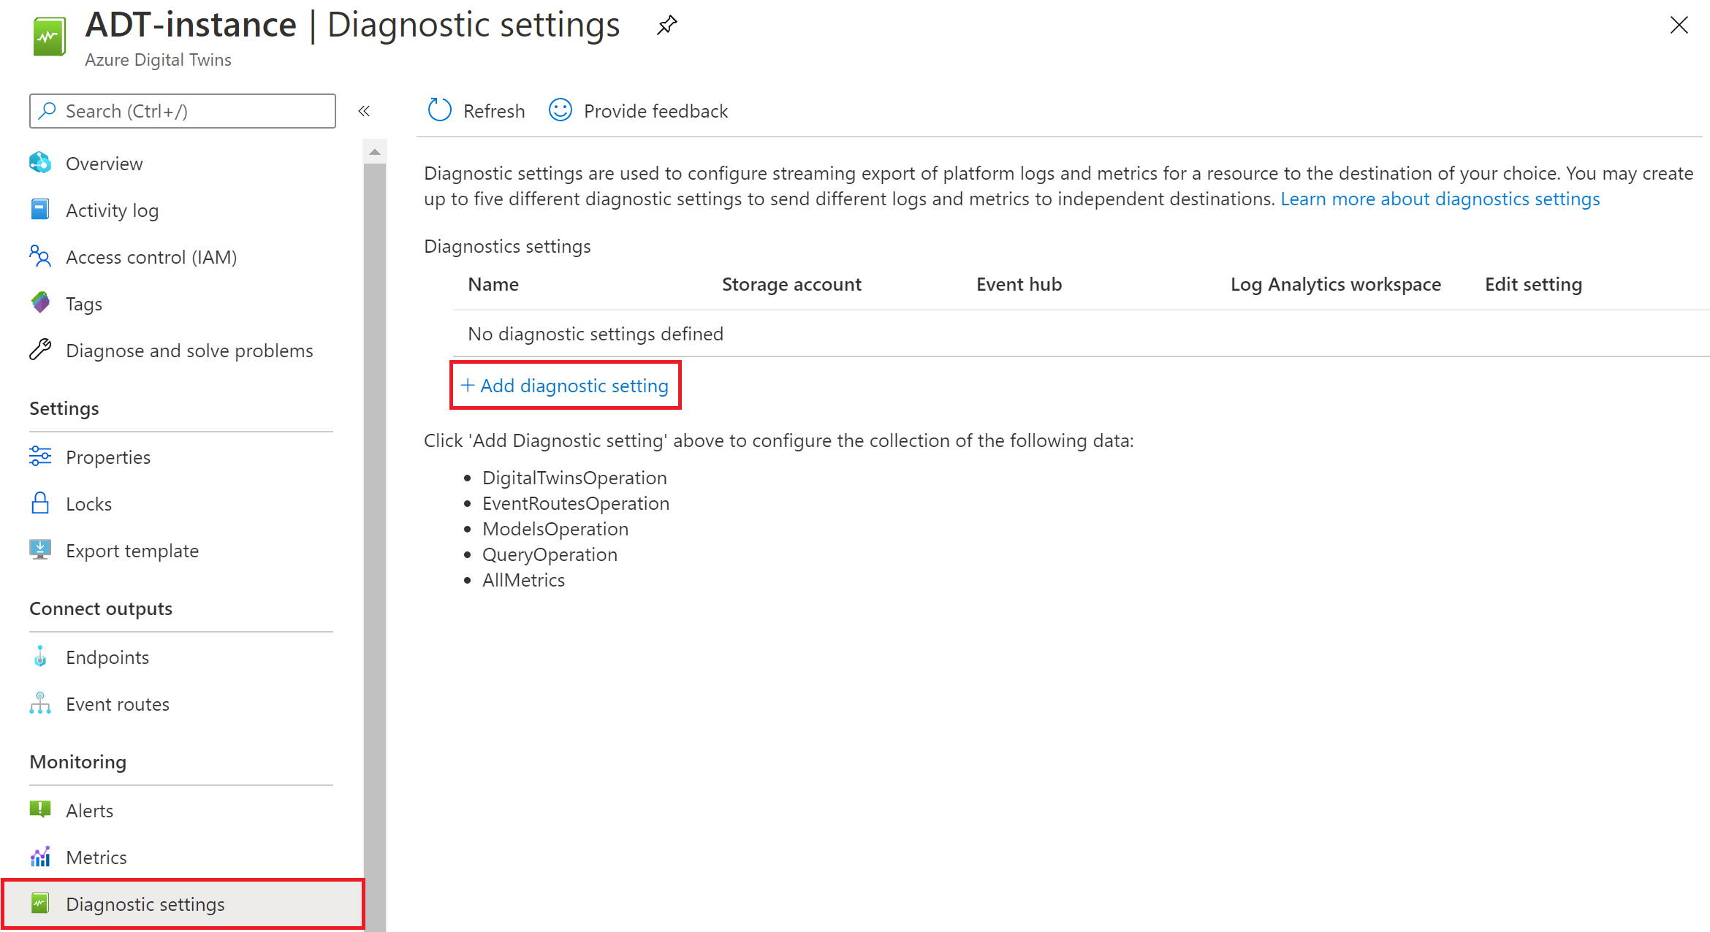
Examine the Azure Digital Twins diagnostic settings
Notes:
Azure Digital Twins can collect logs for your service instance to monitor its performance, access, and other data. You can use these logs to get an idea of what is happening in your Azure Digital Twins instance, and perform root-cause analysis on issues without needing to contact Azure support.
After setting up logs, you can also query the logs to quickly gather custom insights.
You can configure diagnostic settings to start collecting logs from the Azure portal.
The ADT diagnostics logs are divided into the following categories:
ADTModelsOperation: Log all API calls pertaining to Models
ADTQueryOperation: Log all API calls pertaining to Queries
ADTEventRoutesOperation: Log all API calls pertaining to Event Routes as well as egress of events from Azure Digital Twins to an endpoint service like Event Grid, Event Hubs and Service Bus
ADTDigitalTwinsOperation: Log all API calls pertaining to Azure Digital Twins

Slide 33
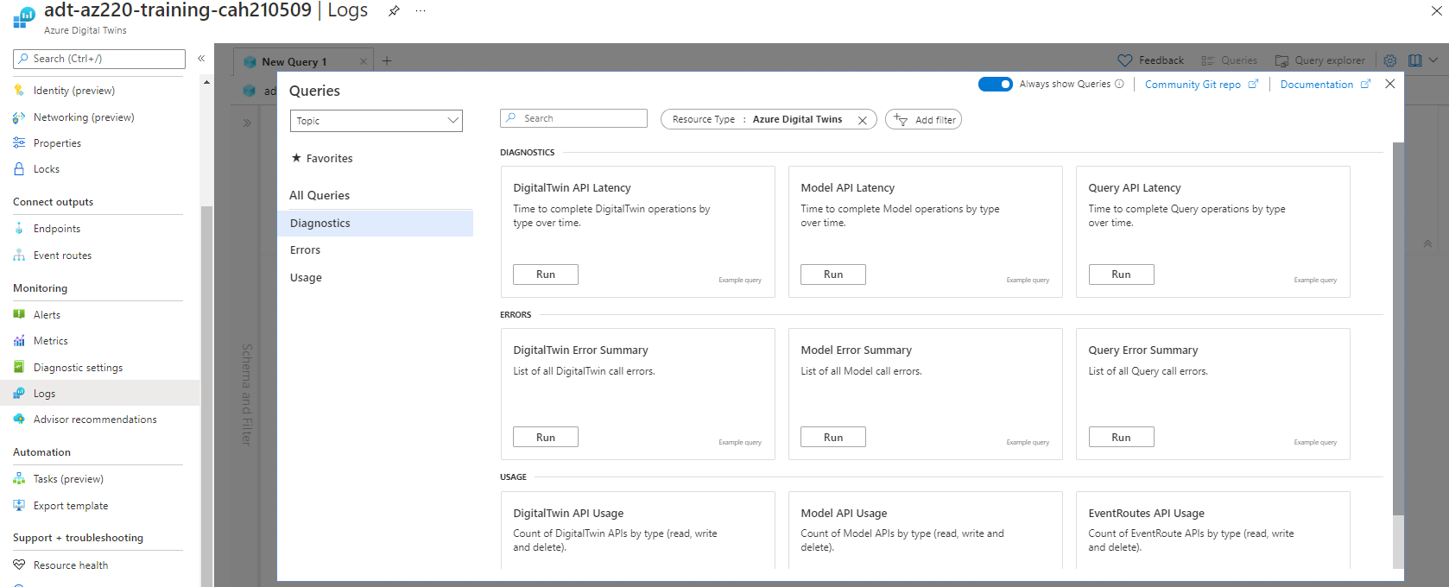
View and query logs
Notes:
With diagnostics logs configured, custom queries can be used to troubleshoot issues and generate insights.
Log queries are accessible from the Azure portal
Prebuilt example queries (shown in the slide image) have been written for various logs. You can select one of the queries to load it into the query editor and run it to see these logs for your instance.
The query editor enables you to customize your queries and provides the following resource tabs:
- Tables: The Tables tab shows the different Azure Digital Twins log categories that are available to use in your queries.
- Queries: The Queries tab contains the example queries that you can load into the editor.
- Filter: The Filter tab lets you customize a filtered view of the data that the query returns.

Slide 34
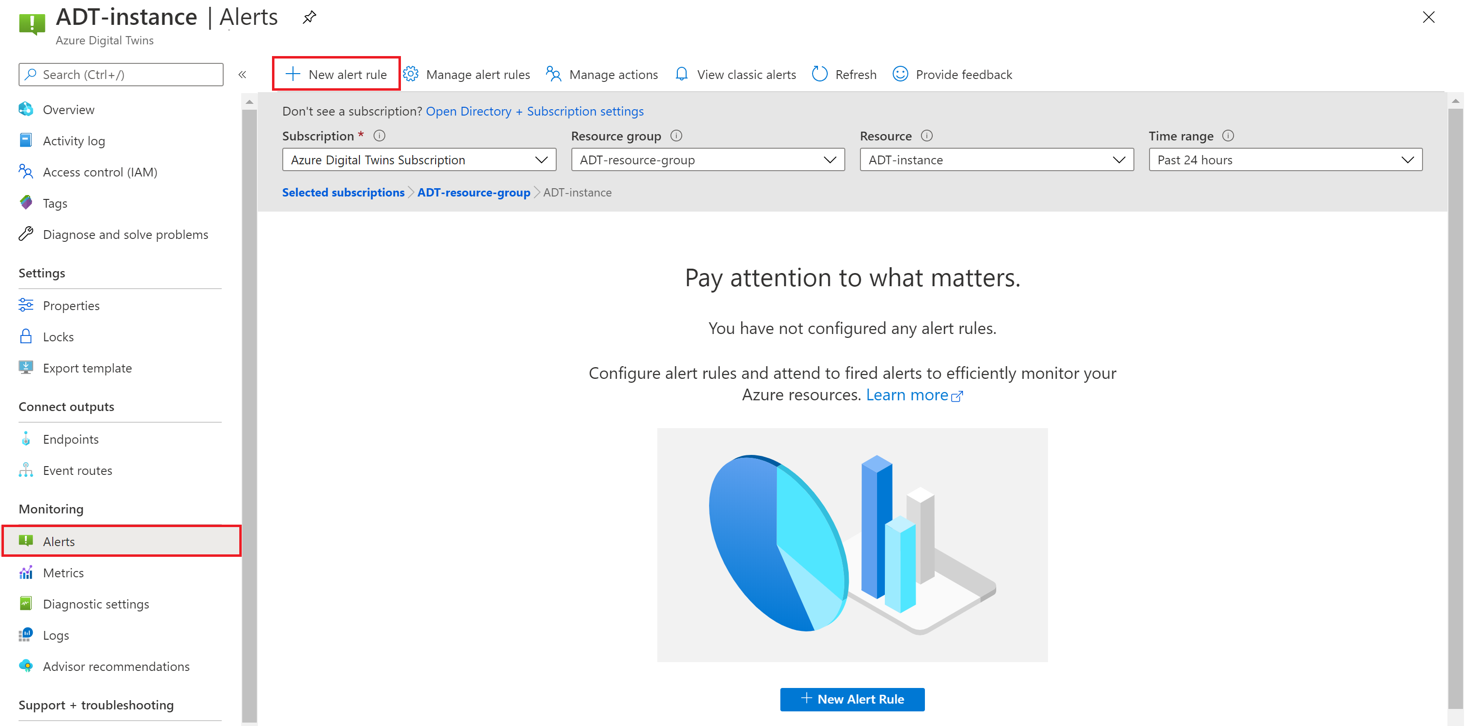
Enable alerts
Notes:
Azure Digital Twins collects metrics for your service instance that give information about the state of your resources. You can use these metrics to assess the overall health of Azure Digital Twins service and the resources connected to it.
Alerts proactively notify you when important conditions are found in your metrics data. They allow you to identify and address issues before the users of your system notice them.
Selecting + New alert rule opens the Create alert rule page, where you can define conditions, actions to be triggered, and alert details.

Slide 35
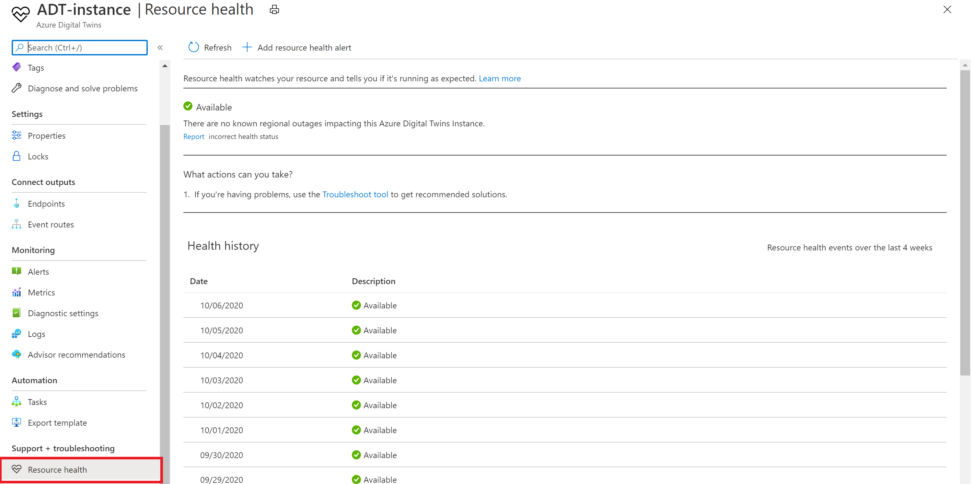
Understand ADT resource health
Notes:
Azure Resource Health can help you monitor whether your Azure Digital Twins instance is up and running. You can also use it to learn whether a regional outage is impacting the health of your instance.
In the example shown here, the ADT instance is showing the current state as Available, and you can see that the resource has been Available for the previous nine days.

Slide 36
Lesson 5: Module Labs

Slide 37
Module 11 Lab
Lab 19: Develop Azure Digital Twins solutions:
Design and develop digital twin models
Create and configure digital twins
Implement ADT graph interactions
Integrate ADT with upstream and downstream systems

Slide 38
Lesson 6: Module 11 review questions

Slide 39
Module review: Question 11.1
You are developing an Azure Digital Twins solution for Contoso that builds on your IoT infrastructure. You have created your ADT instance in the Azure portal.
In order to manage the ADT service and its data, what role assignment must be configured? (choose one best answer)
Answer A:
Contributor
Answer B:
Azure Digital Twins Data Reader
Answer C:
Azure Digital Twins Data Owner
Answer D:
Owner
Notes:
Correct Answer: C
Explanation: In the student workbook/skillpipe content, topic ??????? includes the following:

Slide 40
Module review: Question 11.2
You are developing an Azure Digital Twins solution for Contoso that builds on your IoT infrastructure. You have configured your ADT instance and you are ready to begin building your digital twins environment.
What is the relationship between an ADT model and a digital twin? (choose one best answer)
Answer A:
An ADT model is an instance of a digital twin
Answer B:
A digital twin is an instance of an ADT model
Answer C:
An ADT model contains the digital twins for your ADT environment
Notes:
Correct Answer: B
Explanation: In the student workbook/skillpipe content, topic ??????? includes the following:

Slide 41
Module review: Question 11.3
You are developing an Azure Digital Twins solution for Contoso that builds on your IoT infrastructure.
Which of the following steps must be completed before you can create a digital twin. (choose all correct answers)
Answer A:
Create an Azure Digital Twins instance
Answer B:
Configure Azure Digital Twins access control for a user account
Answer C:
Create and upload a model
Answer D:
Configure an Azure Digital Twins endpoint
Notes:
Correct Answer: A, B, C
Explanation: In the student workbook/skillpipe content, topic ??????? includes the following:

Slide 42
Module review: Question 11.4
You are developing an Azure Digital Twins solution for Contoso Cheese that builds on your IoT infrastructure. You have most of your digital twins environment built when you realize that you need to replace one of the models.
What happens to the associated digital twins when you delete a model? (choose one best answer)
Answer A:
The digital twins are automatically removed from the environment
Answer B:
The properties of the digital twins can no longer be updated
Answer C:
The properties of the digital twins can no longer be queried
Notes:
Correct Answer: B
Explanation: In the student workbook/skillpipe content, topic ??????? includes the following:

Slide 43
Module review: Question 11.5
You are developing an Azure Digital Twins solution for Contoso that builds on your IoT infrastructure. You have built the digital twins environment and you want to build some sample queries. You run the following query:
SELECT T, CT FROM DIGITALTWINS T JOIN CT RELATED T.rel_has_caves WHERE T.$dtId = 'factory_1'
Assuming that the query runs as expected, what results are returned? (choose one best answer)
Answer A:
The "cave" digital twins that have a "rel_has_caves" relationship to the "factory" digital twin with an ID of "factory_1"
Answer B:
The "factory_1" digital twin and all digital twins that are related to it.
Answer C:
The "factory_1" digital twin and all of the digital twins that have a "rel_has_caves" relationship to it.
Answer D:
The "factory_1" digital twin
Notes:
Correct Answer: C
Explanation: In the student workbook/skillpipe content, topic ??????? includes the following:

Slide 44
Module review: Question 11.6
You are developing an Azure Digital Twins solution for Contoso Cheese that builds on your IoT infrastructure. Your digital twins environment includes twins that support telemetry coming from IoT hub devices.
Which Azure service will you use ingest telemetry from the upstream IoT hub? (choose one best answer)
Answer A:
Azure Device Provisioning Service
Answer B:
Azure Function
Answer C:
Azure Time Series Insights
Answer D:
Azure Digital Twins Explorer
Notes:
Correct Answer: B
Explanation: In the student workbook/skillpipe content, topic ??????? includes the following:

Slide 45
Module review: Question 11.7
You are developing an Azure Digital Twins solution for Contoso Cheese that builds on your IoT infrastructure. Your digital twins environment includes a hierarchy of digital twins that related using a variety of relationship. To use Azure Time Series Insights as a downstream service for analyzing ADT data you need to configure an endpoint.
What endpoint types does ADT support? (choose all correct answers)
Answer A:
Azure Event Hubs
Answer B:
Azure Event Grid
Answer C:
Azure Service Bus
Answer D:
Azure Storage container
Notes:
Correct Answer: A, B, C
Explanation: In the student workbook/skillpipe content, topic ??????? includes the following:

